Slide 1
GRAM PANCHAYAT SERVICES
Presented By
ELIZABETH KURIAKOSE
ROLL NO:61
TVE20MCA-2061
UNDER THE GUIDANCE OF
PROF. DEEPA S

Slide 2
INTRODUCTION
Gram Panchayat is a local government unit in rural India.
It is essential that every citizen may properly get the services of Gram Panchayat.
This project is aimed at developing an android application that will provide services of Panchayat.
Through this application public can easily contact with Panchayat regarding any issues such as availing for services, application filling and feedbacks.

Slide 3
EXISTING SYSTEM
In the present scenario, various government services are published in print media and advertised by respective departments.
The people in the rural areas have to go to Panchayat office to apply and get their certificates from the office.
lsgkerala.gov.in is the official website for LSGD(Local Self Government Department) services that provide all services through online.
However for the people in the rural area it is difficult to properly handle the website.

Slide 4
DISADVANTAGE OF EXISTING SYSTEM
It requires lot of time and may result in work delay.
It is often difficult for people to get the relevant information and approach the officials for availing the services.
It will not track the status of files that were applied.
People in the rural area have to go to e-centers for availing services.

Slide 5
PROPOSED SYSTEM
What is GRAM PANCHAYAT SERVICES AND CHECK ELIGIBILITY SYSTEM
The proposed system aims to develop an application that informs public about schemes of Gram Panchayat and check the eligibility of the citizen and notifies them.
Gram Panchayat will have so many functions like introducing different kinds of schemes and provide the information about those schemes.
Some services provided by Panchayat are,
Birth & Death Registration
House Tax
Old Age and Other Pensions
Land Records Access
Marriage Certification and etc.

Slide 6
Some schemes and projects under Panchayat are,
Life Housing Project
Indira Awas Yojana
Pradhan Mantri Awas Yojana
Haritha Keralam
Financial Assistance Project and etc.
So through this application the people can be aware of the services and check the eligibility for applying for a particular plan or scheme.

Slide 7
USERS
Public
Staff (Admin)

Slide 8
MODULES
Public Management
Registration
Updates
Schemes and Services Management
Introducing new schemes
Check eligibility for a particular scheme
Apply for schemes and services
Track the status of application

Slide 9
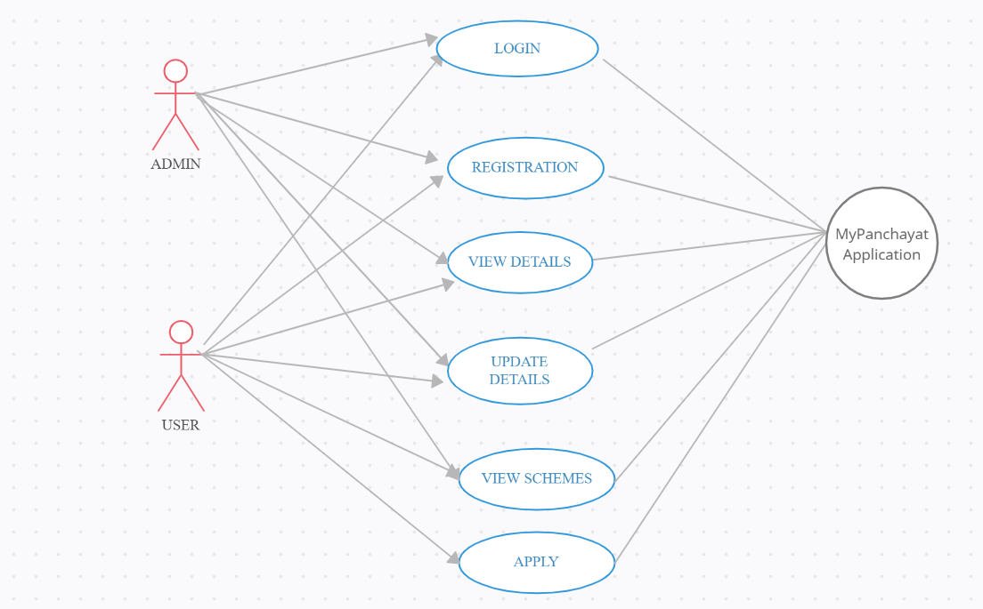
USE CASE DIAGRAM

Slide 10
ADVANTAGES
Simple, accurate and efficient application, any person with a mobile can effectively use this application.
An application for GRAM PANCHAYAT SERVICES will be useful for both the public and staff.
This application provides online method for informing public about schemes of Gram Panchayat and check the eligibility of the citizen and notifies them.
Provide user friendly method for availing the schemes.
Authority can easily check details.

Slide 11
REFERENCES
Pratiksha Dhage, Shital Wathore, Prof. Vidya Jagtap , “E-GRAM PANCHAYAT MANAGEMENT SYSTEM” , OPEN ACCESS INTERNATIONAL JOURNAL OF SCIENCE AND ENGINEERING , 2018 DECEMBER
Suksham Gupta, David, Nishchal Kumar, Vicky Kumar Verma, Aditya Kumar, Akshar Kumar Kashyap , “E-Panchayat- A Smart Solution” , International Journal of Creative Research Thoughts (IJCRT) , 5 May 2021
https://lsgkerala.gov.in

Slide 12
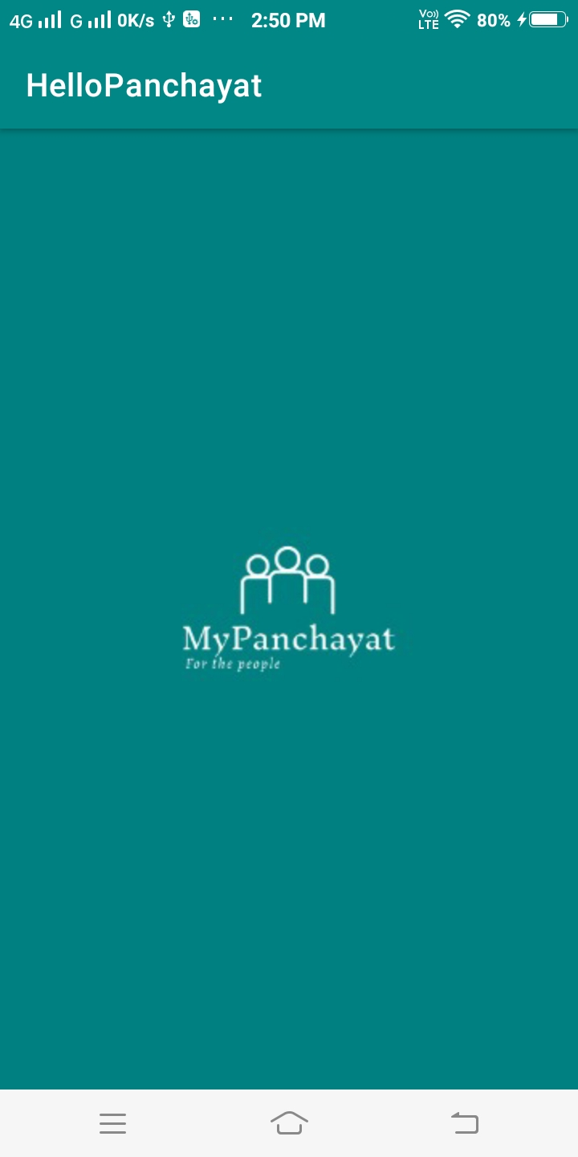
HOME PAGE

Slide 13
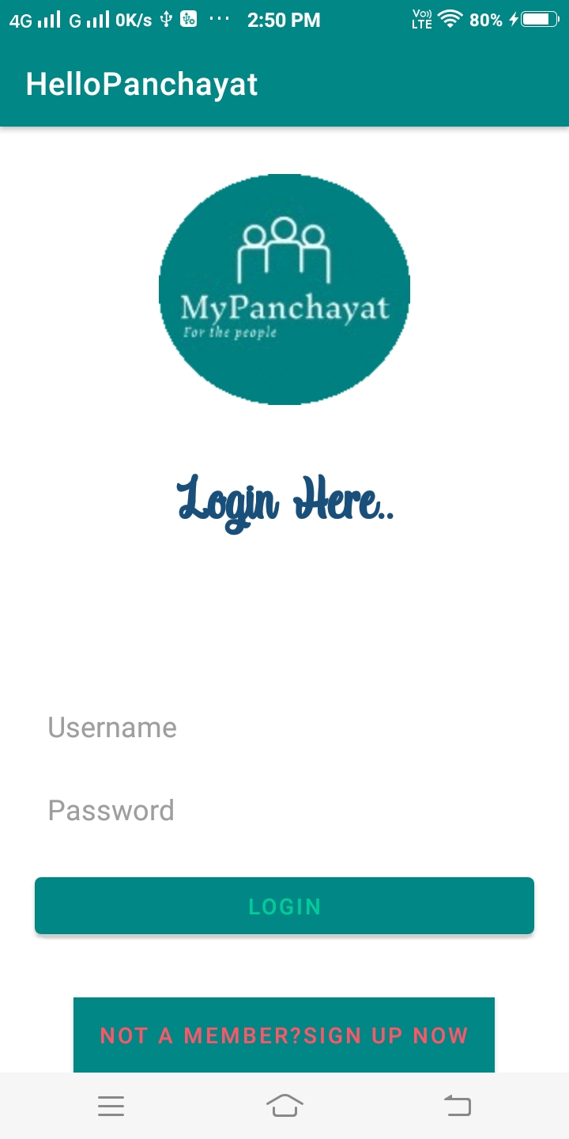
LOGIN

Slide 14
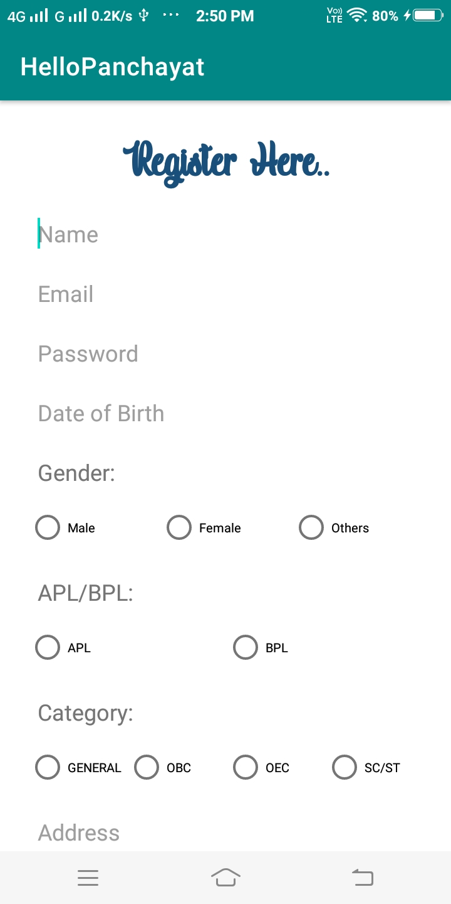
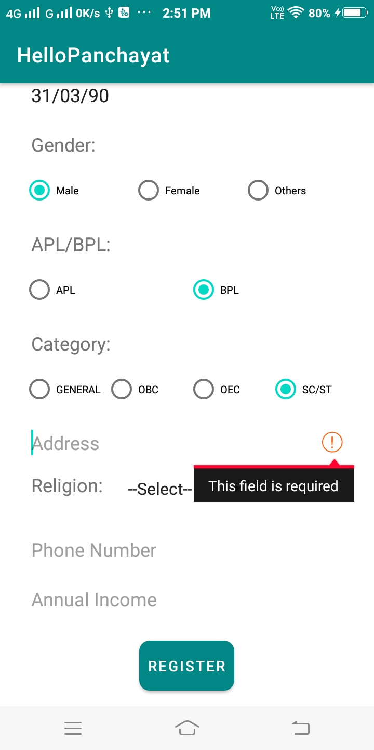
REGISTRATION

Slide 15
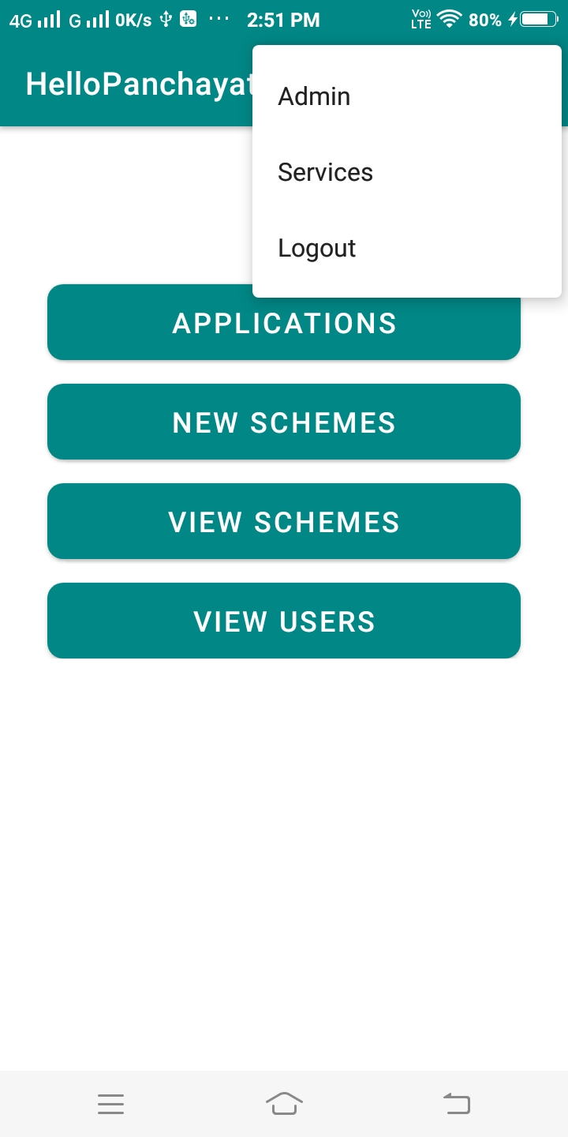
ADMIN HOME

Slide 16
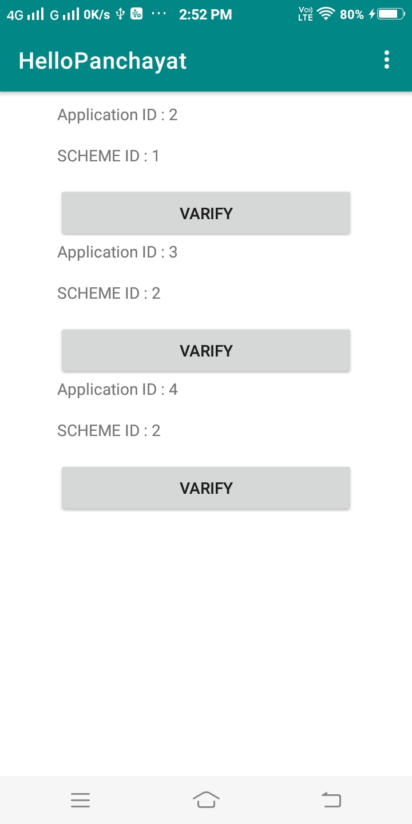
VIEW APPLICATIONS

Slide 17
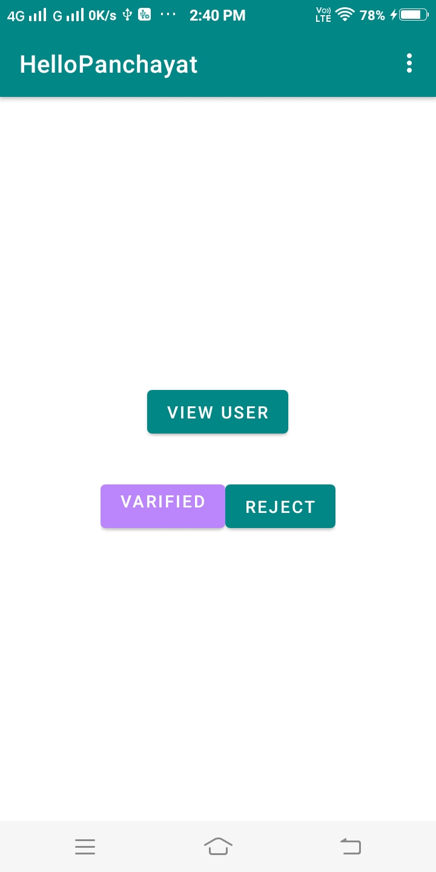
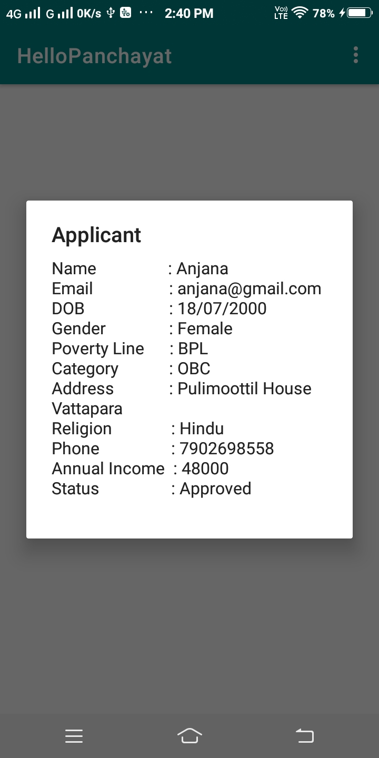
VERIFY APPLICATIONS

Slide 18
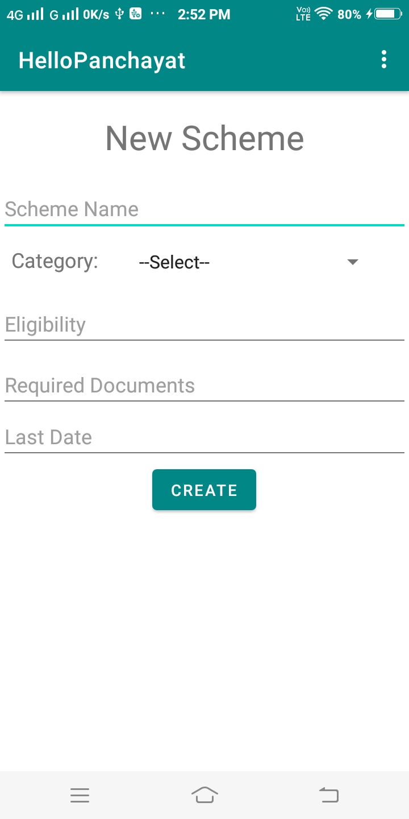
CREATE NEW SCHEME

Slide 19
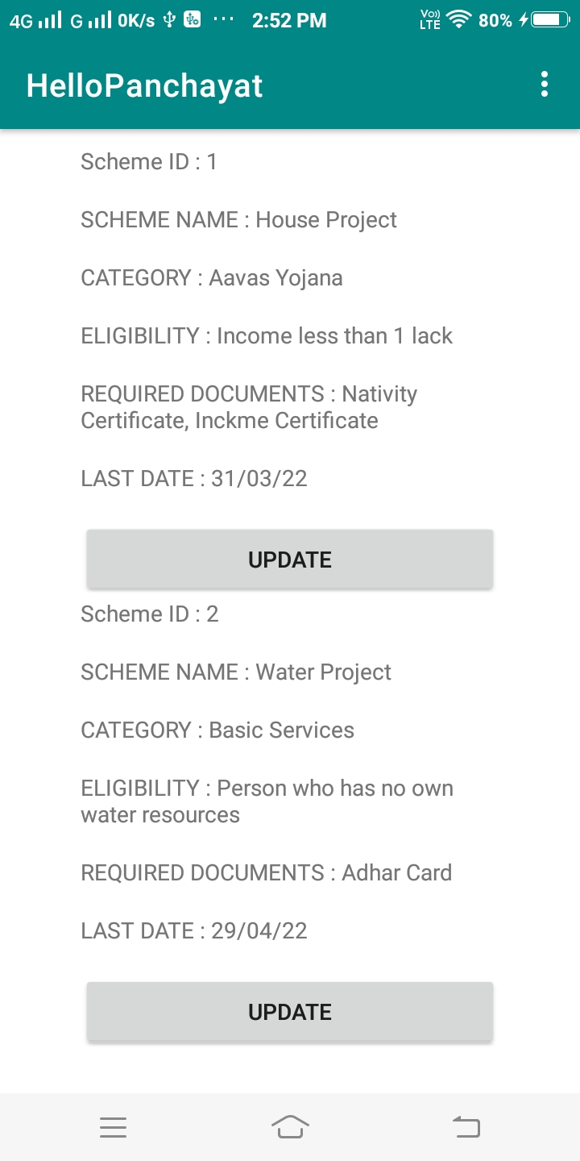
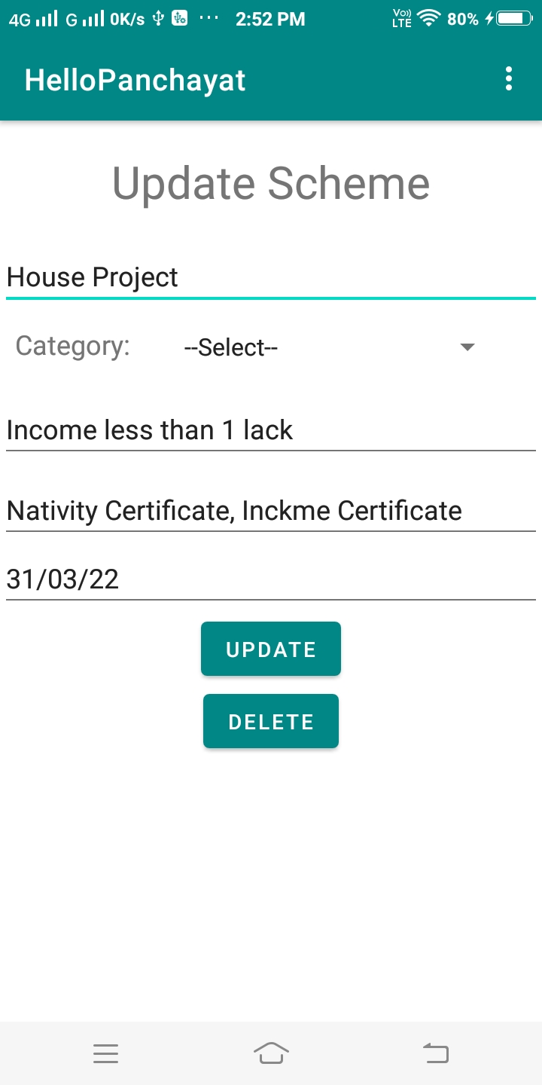
UPDATE SCHEME

Slide 20
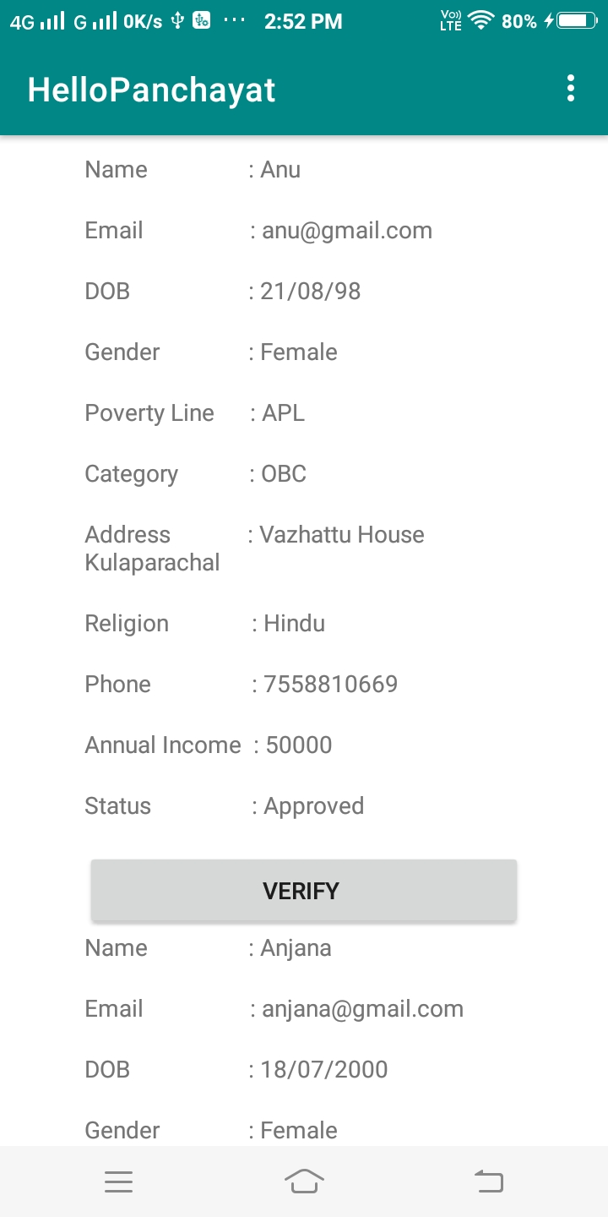
VIEW USERS

Slide 21
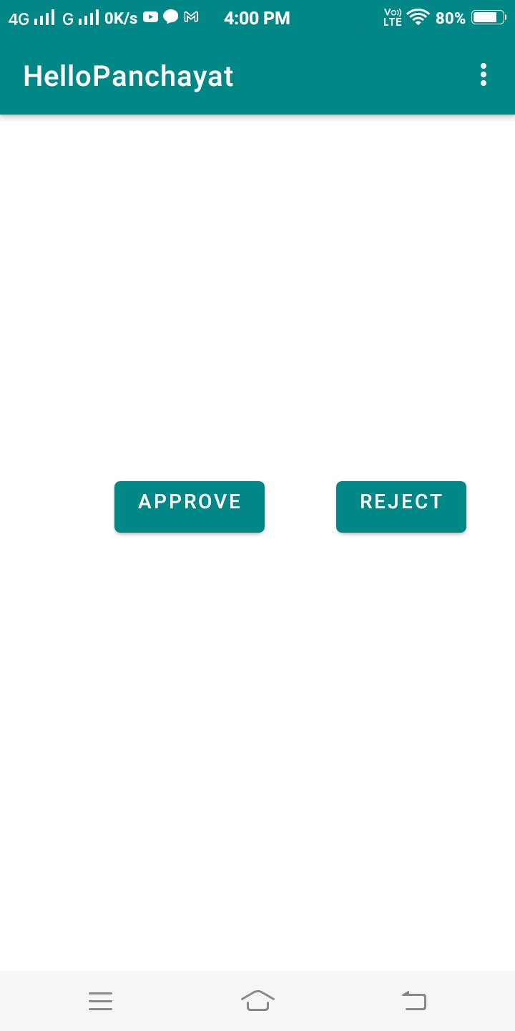
VERIFY USER

Slide 22
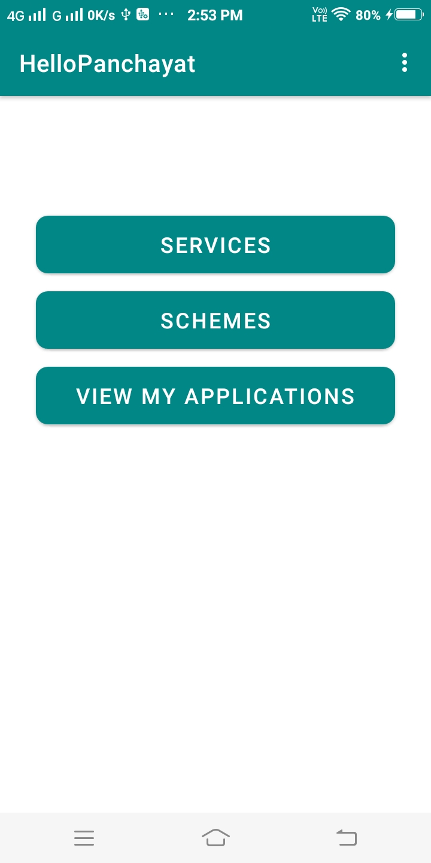
USER HOME

Slide 23
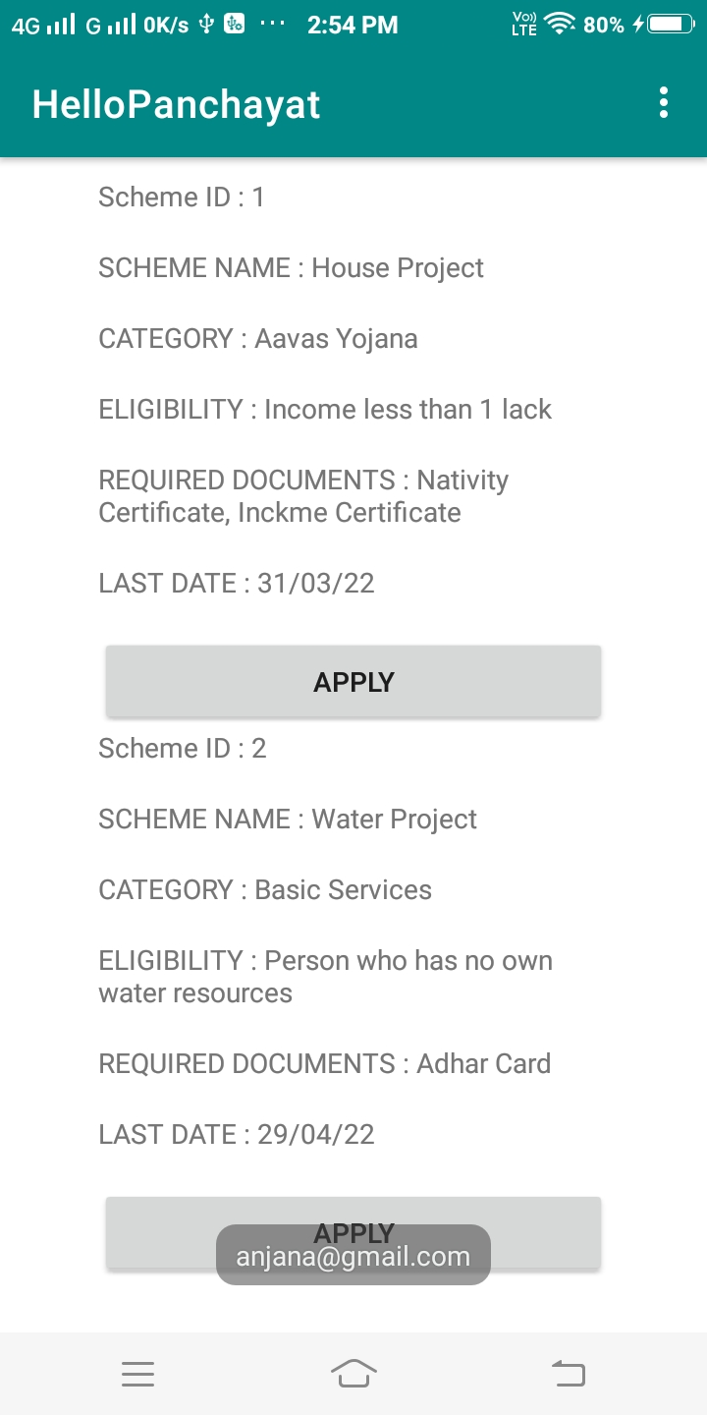
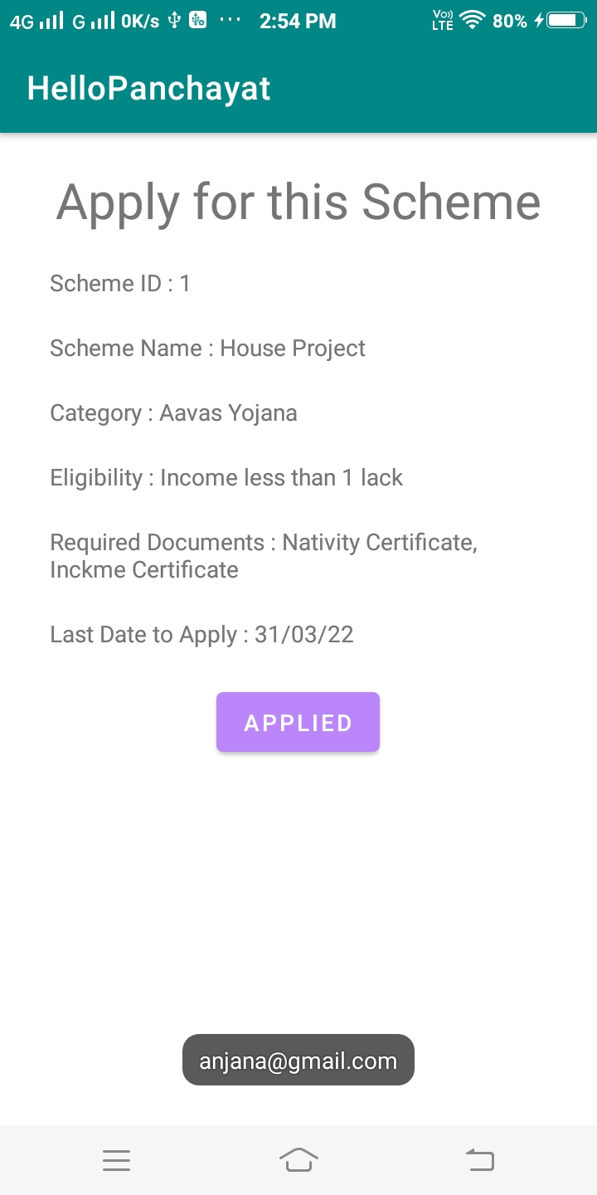
APPLY SCHEMES

Slide 24
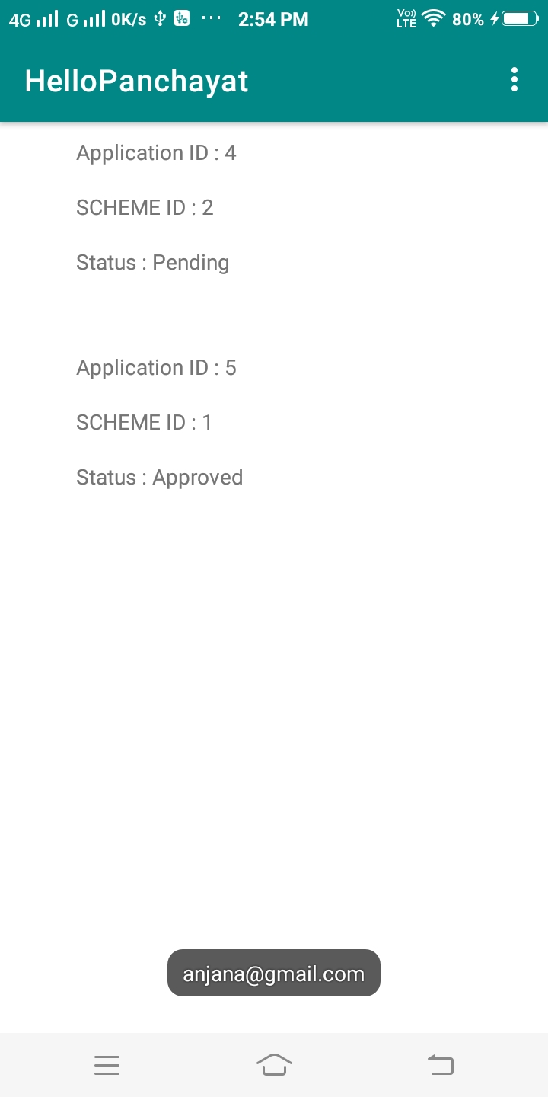
VIEW PREVIOUS APPLICATIONS

Slide 25
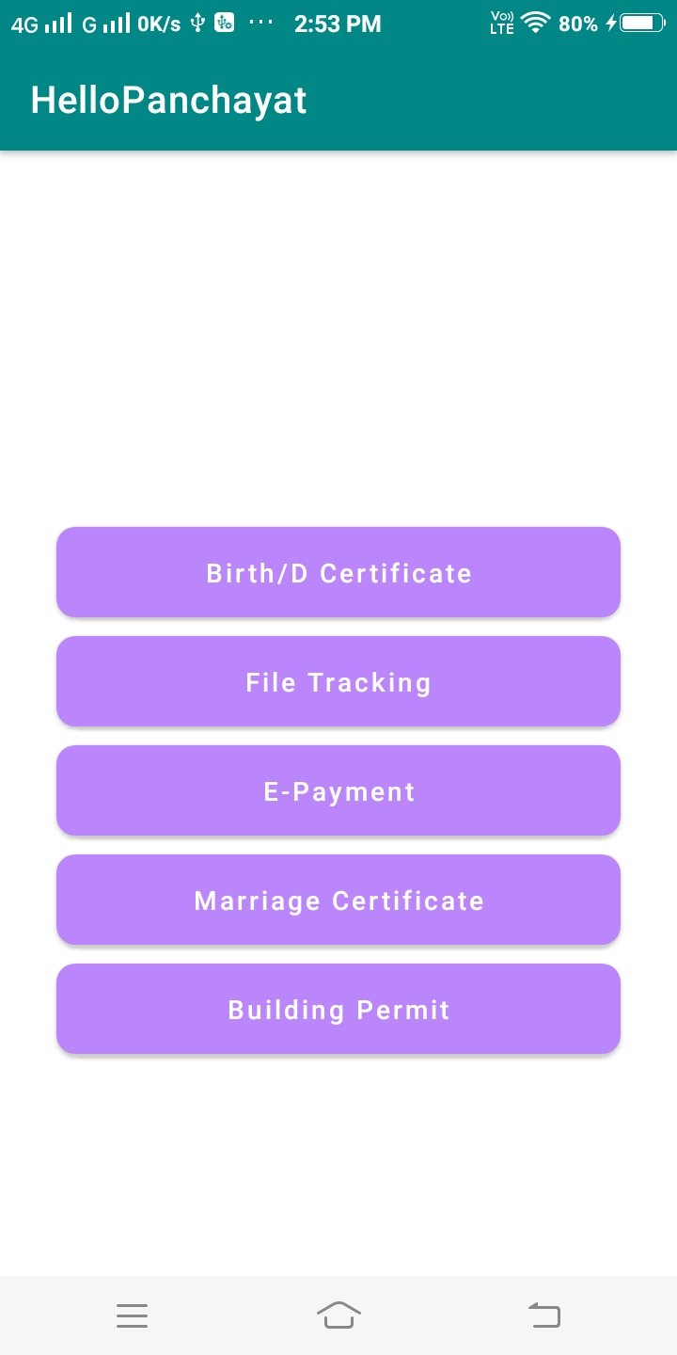
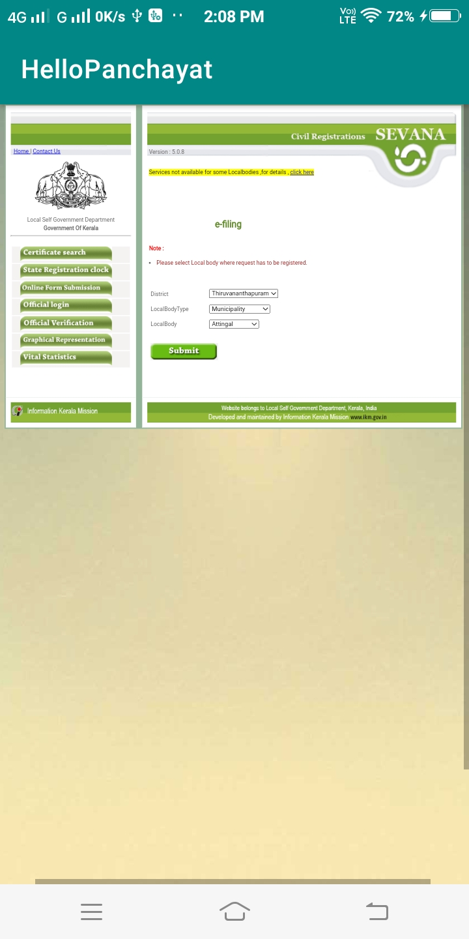
SERVICES

Slide 26
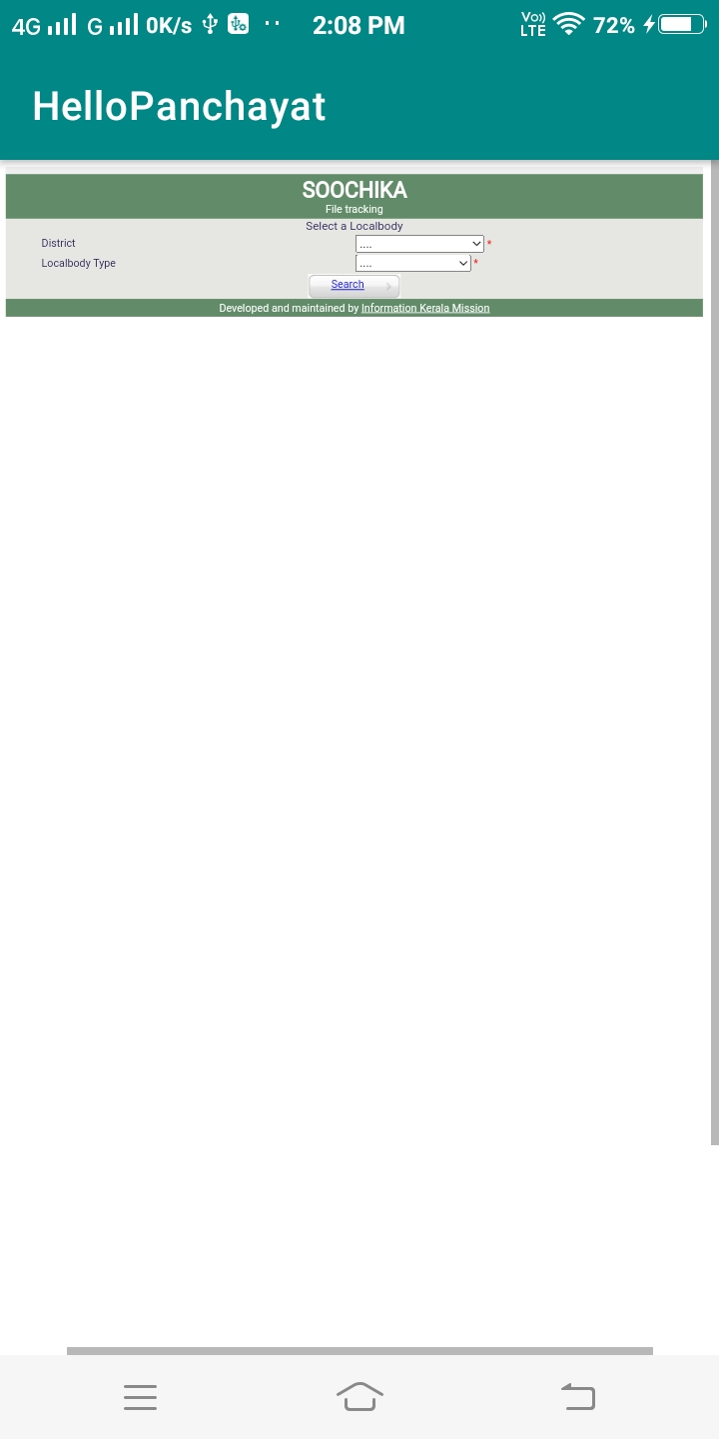
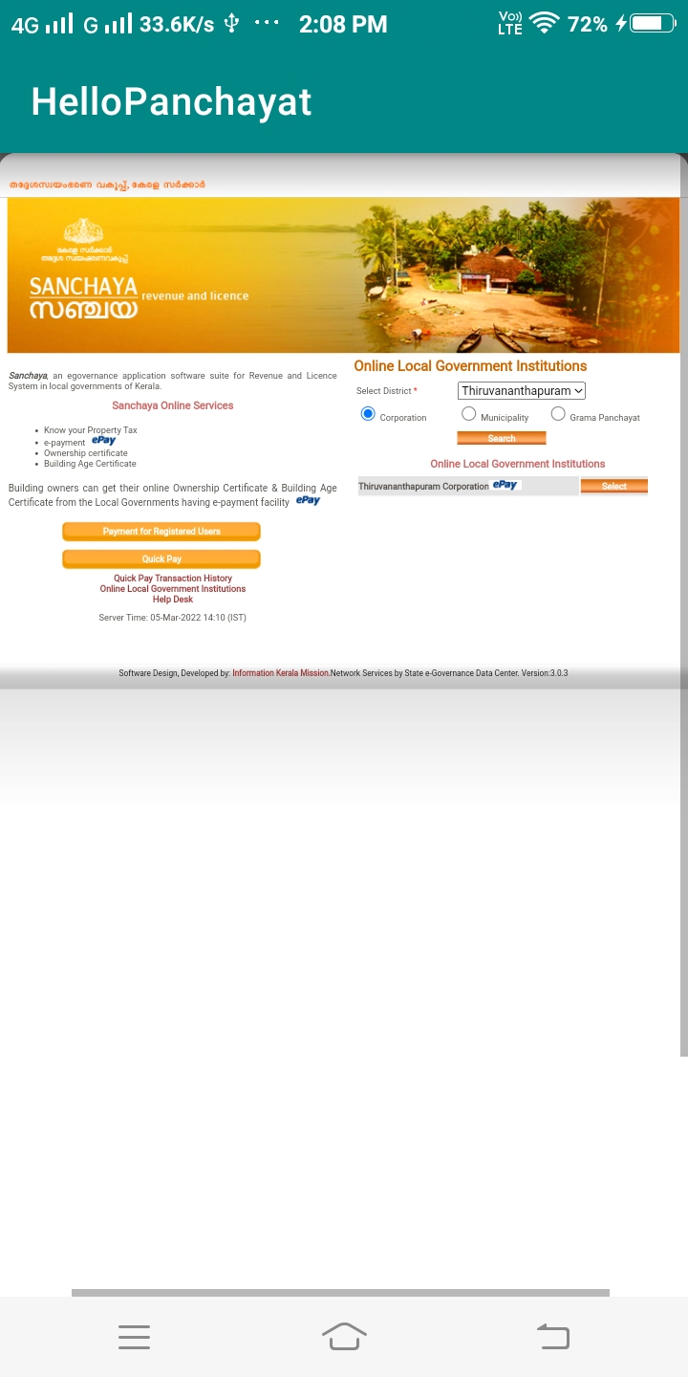

Slide 27
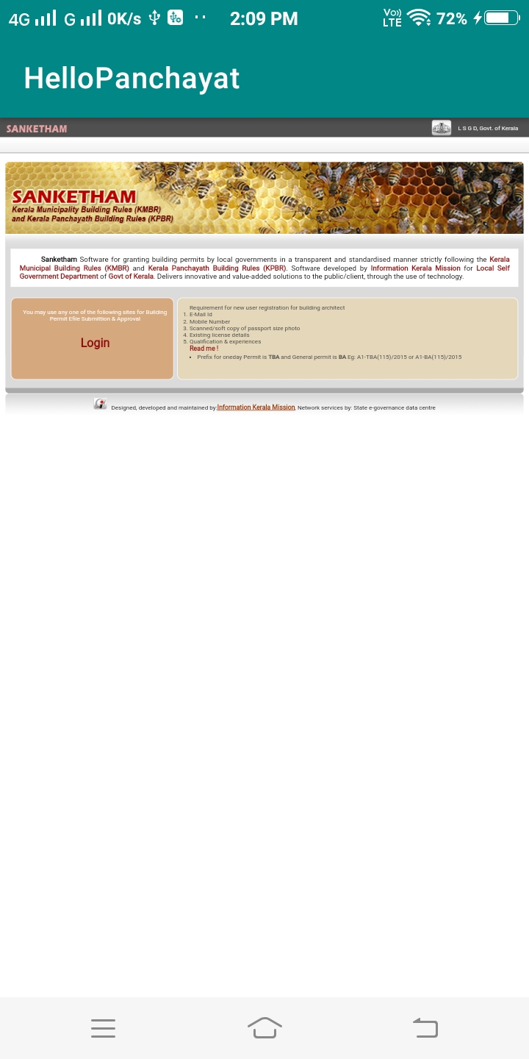
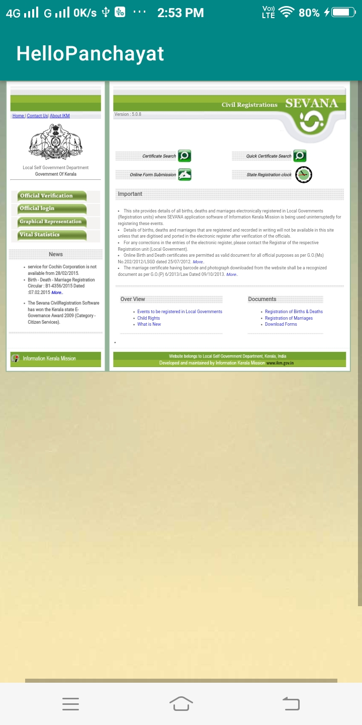

Slide 28
CONCLUSION
Thus, GRAM PANCHAYAT SERVICES AND CHECK ELIGIBILITY SYSTEM will be more useful for the public to get the needed services at the right time without delay.
View all schemes, updating the details, applying for schemes and services can be done through this app.
Each and every person who uses the system can know about the new schemes and projects introduced under Gram Panchayat without any delay.
Public can apply for services through this app thus reduces time.

